Slide 1

IMS PROJECT:
BY JAKE REID

Slide 2
Planning of the project:
Risk assessment
Agile

Slide 3
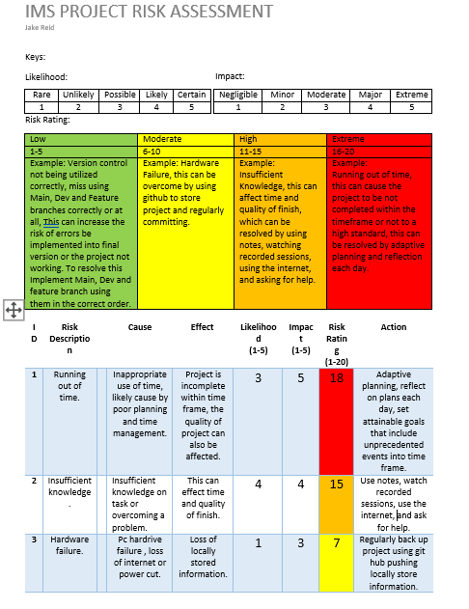
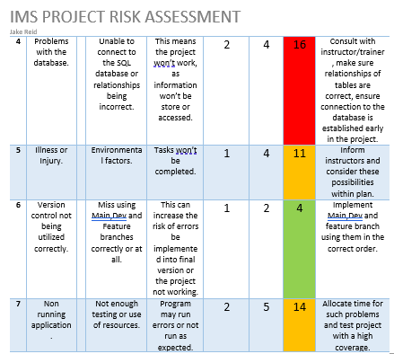
Risk Assessment

Slide 4
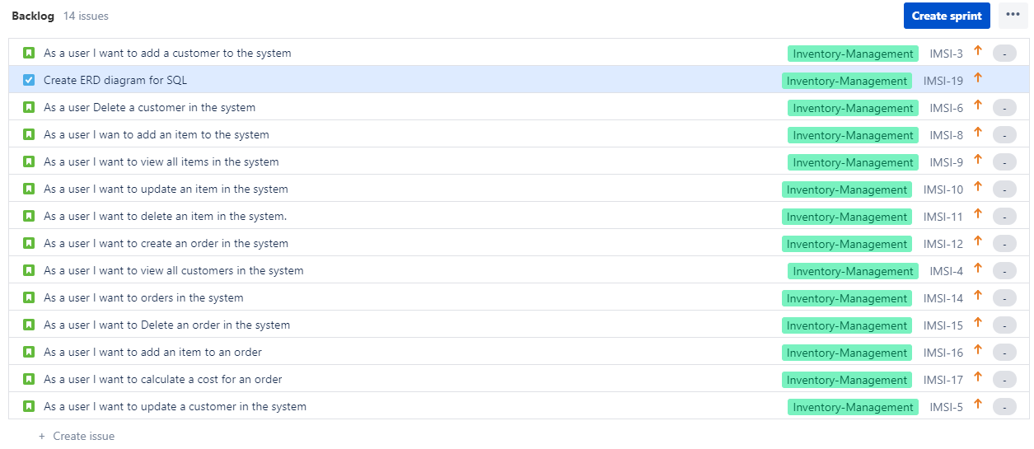
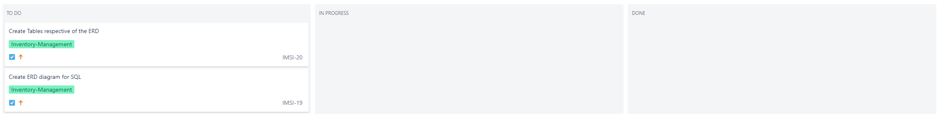
Utilizing Jira:

Slide 5
Ci pipeline
PLAN (JIRA,ERD,RISK ASSESMENT)
CODE (ECLIPSE ,SQL)
TEST
COMMIT (GIT)

Slide 6
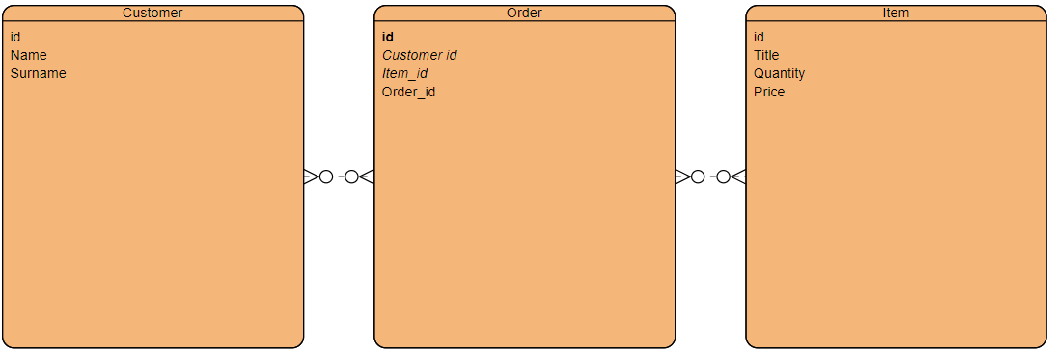
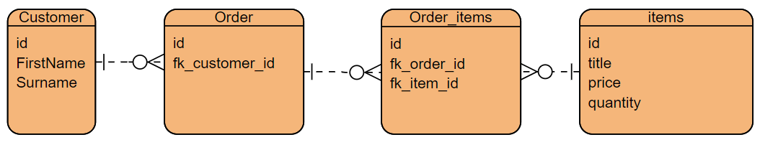
ERD
Before
After

Slide 7
RUNNER
CUSTOMER CONTROLLER
CUSTOMER DAO
IMS
CRUD CONTROLLER INTERFACE
ITEM CONTROLLER
DAO INTERFACE
ITEM DAO
ORDER CONTROLLER
ORDER DAO

Slide 8

Demo

Slide 9
Consultancy Journey
Agile-Scrum, Kanban , poker(Jira)
Database-MySQL/GCP, ERD
Programming Language- Java
Testing- Junit , Mockito
Build tool- Maven
Software applications- Eclipse, MySQL workbench

Slide 10
conclusion
I would utilize git a lot more than I have previously.
I would use Jira more to strategize and tick tasks of the list.

